Slide 1
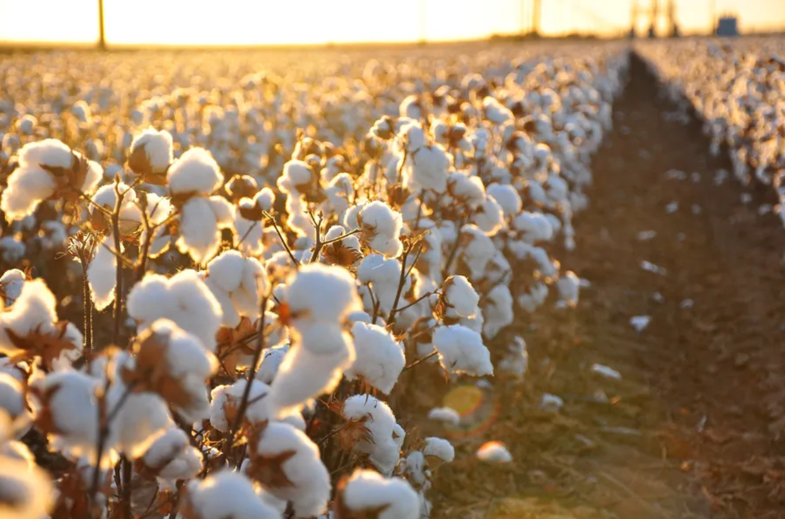

AGR
NET
by Milkyway Biotechs
For NASA Space Apps Challenge

Slide 2




What is Agronet?
General Information
Real Problem driven idea
AgroNet is innovative web-based platform designed to leverage NASA's open data to help farmers worldwide make informed decisions about their crops.
It focuses on :
Providing data-driven insights for agricultural purposes, with a special focus on cotton production.
The platform uses environmental monitoring, and community-driven data for:
Collaboration and notifications alerts between users with heatmaps driven by pushed button alerts farmers
Facingclimate-related challenges, pests, and other agricultural risks.
Cotton is a key crop in Greece, producing 305,000 tons of high-quality fibers in 2022.
Cotton yields are threatened by the Helicoverpa armigera or else green warm , a major pest. Helicoverpa armigera is favored from high tempratures 25-30 Celsius.
So, we detect areas of Evoia , Greece that has been growing cotton crops and from data driven infrormations about weather condition give to farmers indications about the area of their interest to grow their cotton crops.
Also Greece suffered from fires and fires that destroy fields and properties .Current platform gives the ability to add manual alerts for fires and online notifing near by users

Slide 3
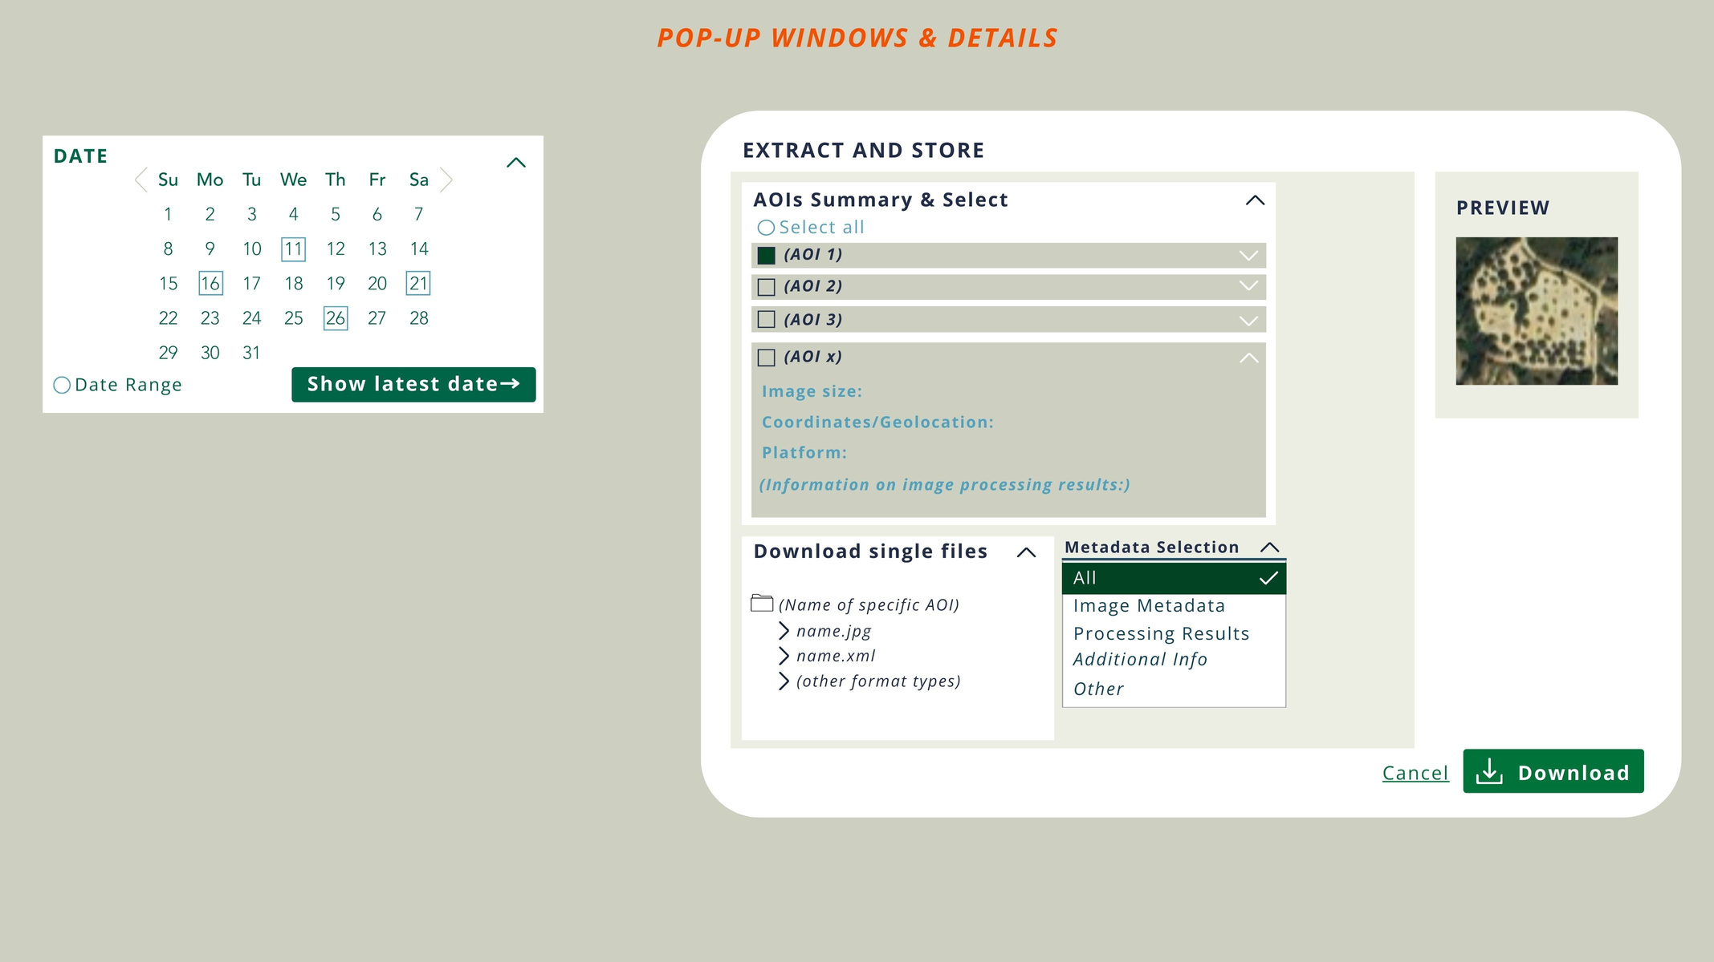
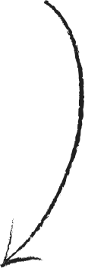
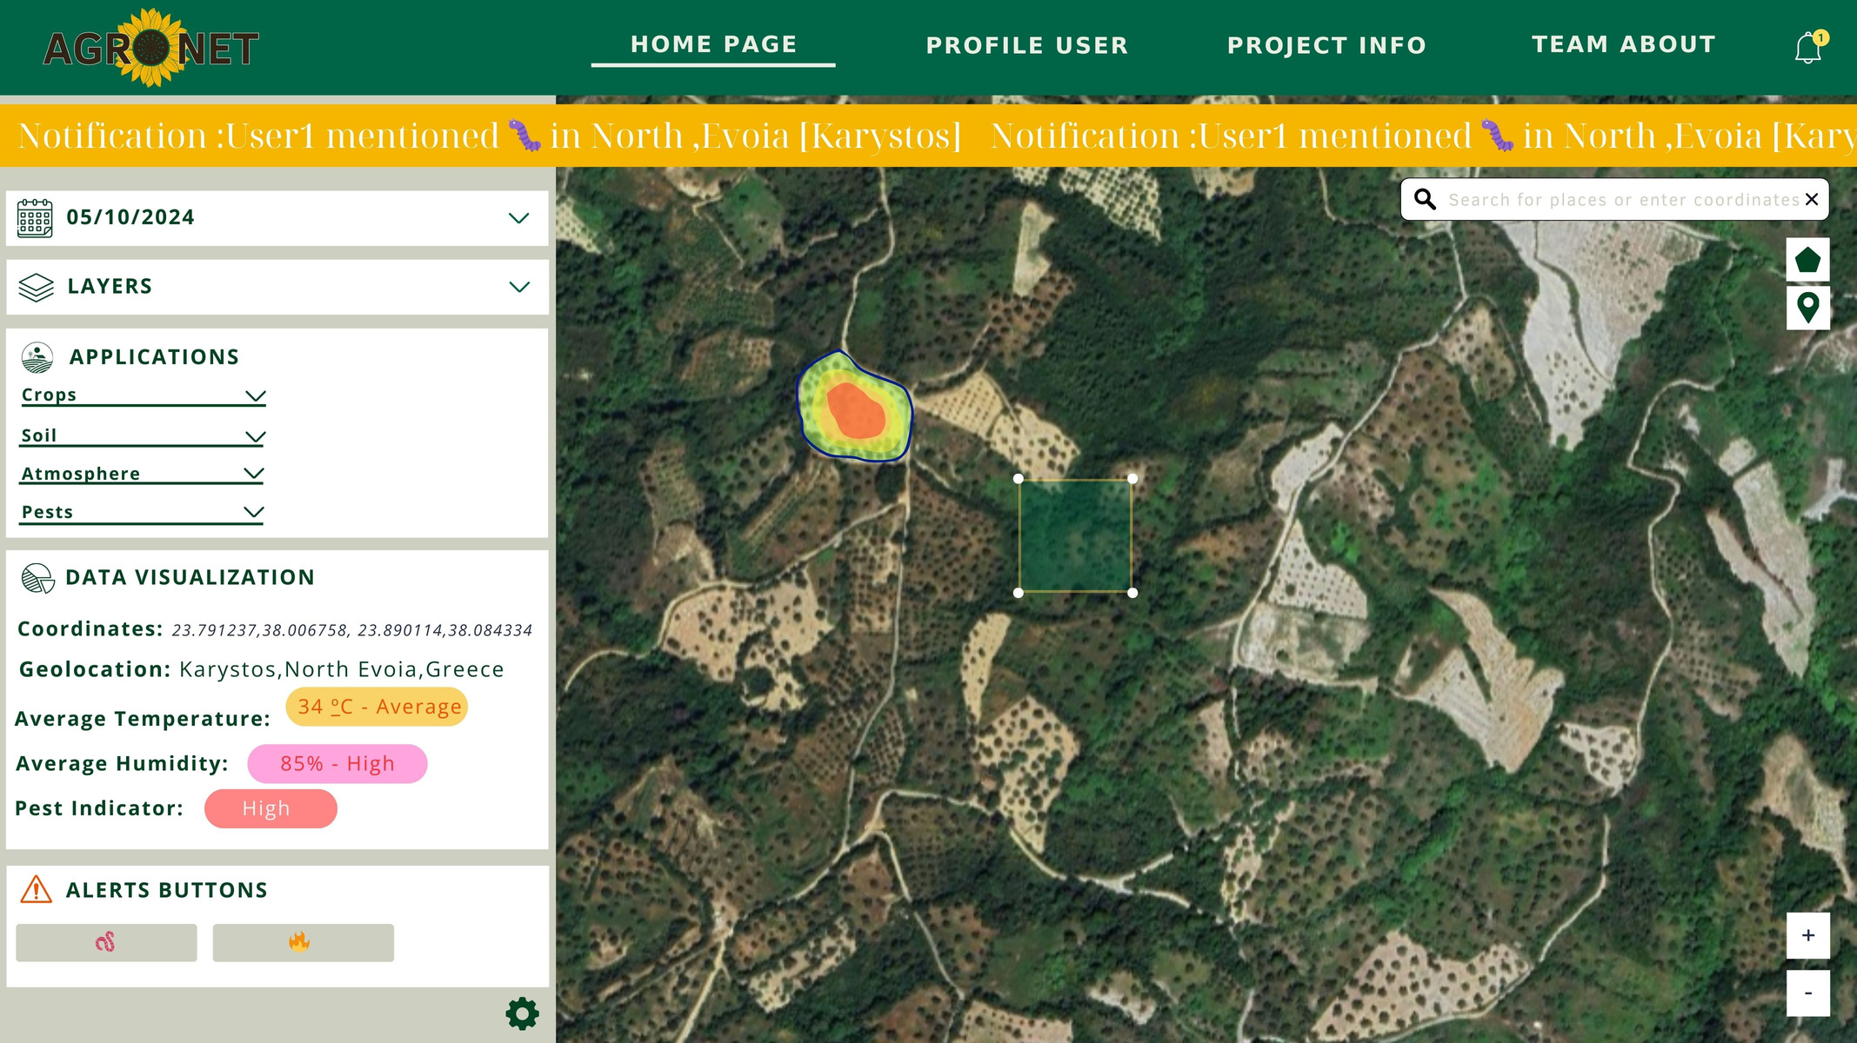




Home Page of Agronet
Heatmap
Live Notifications Alert
Date parameter
AOI Determination
NASA Data driven
informations
Alert Button

Slide 4
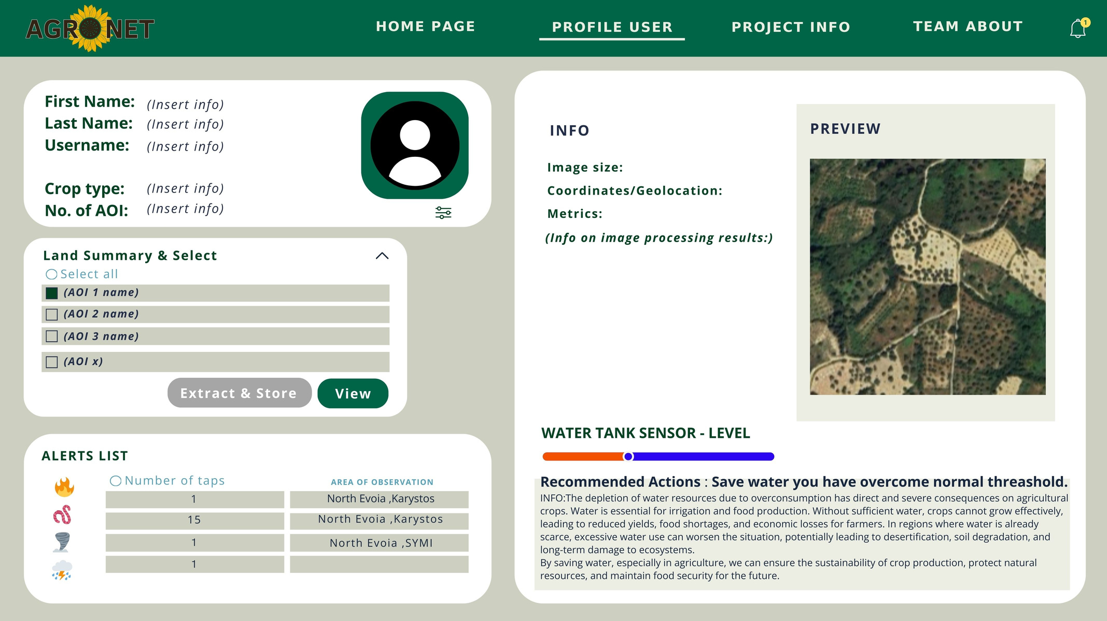
PROFILE USER
User Information
Location & imaging settings
Map Preview
Land Selection
Water levels based on control systems alogirthm recommendations
Alerts based on live interaction

Slide 5

POP-UP WINDOWS & DETAILS
Saving and extracting metadata
Previewing Image of selected area
AOI : area of interest
Ability of extracting in different type of files

Slide 6
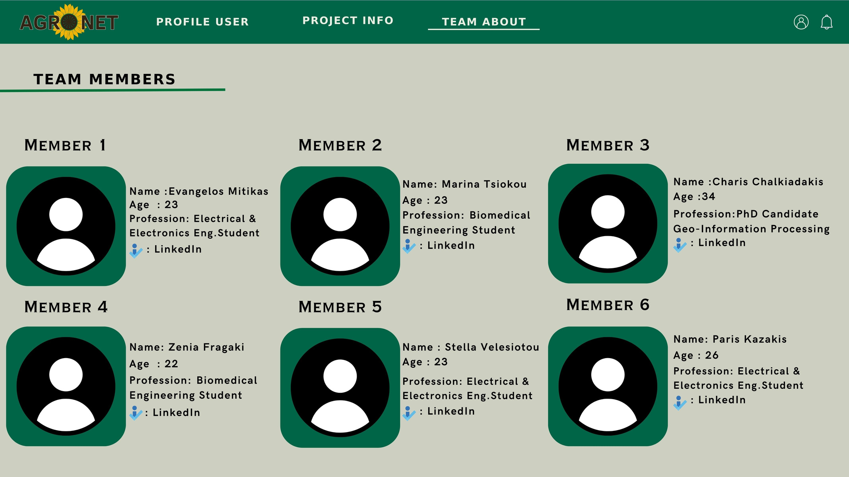
TEAM ABOUT
Basic Informations of Team Members that participated in Nasa Space App Challenge 2024

Slide 7

Can AgroNet be used globally ?
Why AgroNet?
Yes it can.Our web platform in this current example is focused on Evoia Greece cotton crops and the real problems that farmers are facing.But this is just an example , our platform is designed for globally to optimized farming experience
Basic characteristics :
-Scalability
-Versatillity
AgroNet Key Benefits:
Improved Crop Management: Farmers get timely, relevant data to protect their crops from pests and weather extremes.
Enhanced Collaboration: The community-driven heatmap and real-time chat promote knowledge sharing and collective problem-solving.
Water Efficiency: The integration of rain data helps farmers optimize irrigation, conserve water, and save costs.
Proactive Pest Control: Automated alerts about pests like green worms help farmers respond quickly, reducing crop damage.
Climate Resilience: Farmers in regions like Evia, Greece, can better prepare for the effects of climate change, such as wildfires and windstorms.
Predictive Pest Risk Visualization: The heatmap feature provides real-time visualization of pest risks, primarily focused on the cotton bollworm , allowing farmers to anticipate and prevent infestations before they cause significant damage.

